Slide 1
Chap.2 Transmission Line Theory
§2-1 The lumped-element circuit model for a transmission line
1.Transmission line

Slide 2
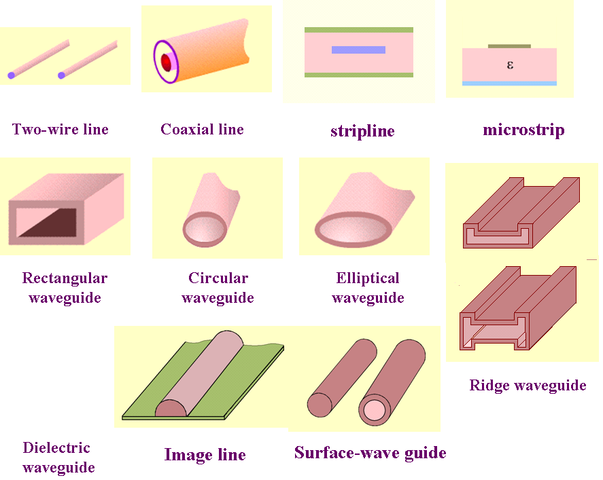

Slide 3
Classification of Transmission Line
TEM or quasi-TEM transmission line
Classified by
guided wave mode
Hollow metal pipe
(TE or TM)
Surface-wave waveguide

Slide 4
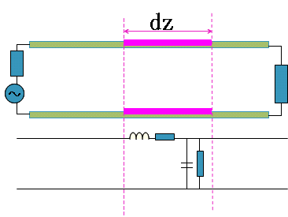
2-1 The lumped-element circuit model for a Transmission line (TL)
Electric Length： le=l_{P} / λ, Physical length/Wavelength
long lines (le is large than 1 or in the order of 1) and short lines (le is much less than 1)
A TL is a distributed-parameter network
Voltage and Current are different at different position, are the function of time and space.

Slide 5

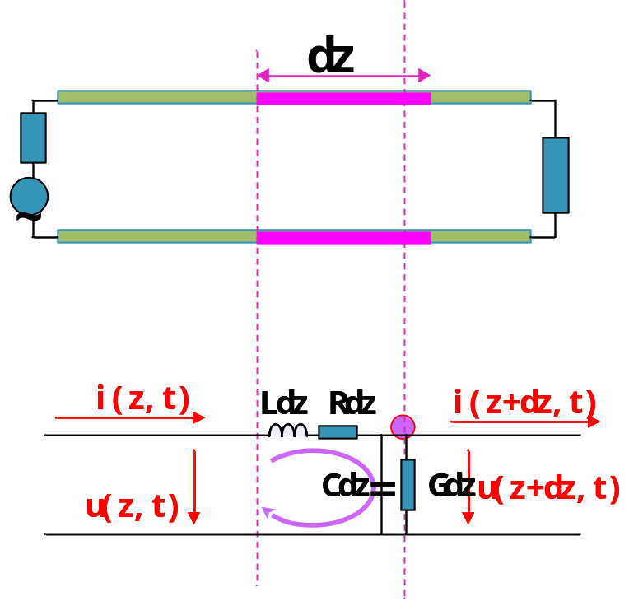
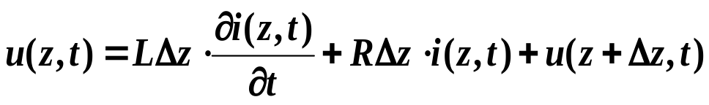
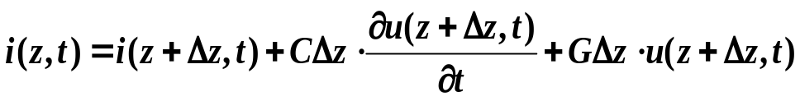

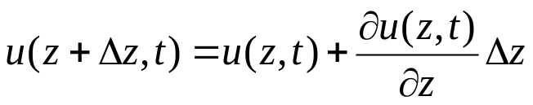
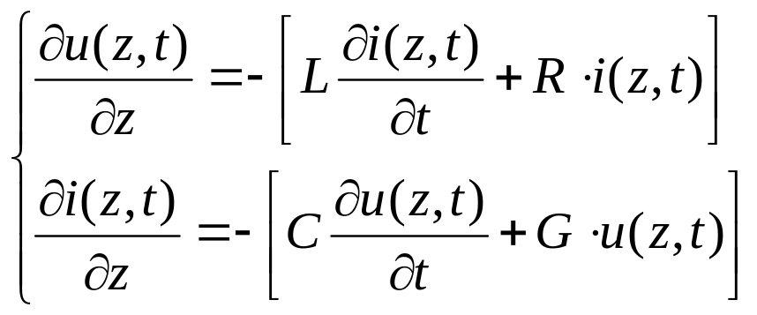
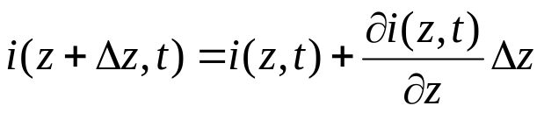
2-1 The lumped-element circuit model for a Transmission line
R: series resistance per unit length, for both conductors, in Ω/m
L: series inductance per unit length, for both conductors, in H/m
G: shunt conductance per unit length, S/m
C: shunt capacitance per unit length, F/m
Kirchhoff’s voltage and current law leads to
Dividing by Δz, and taking the limit as Δz→ 0，
Transmission line / telegrapher equations

Slide 6
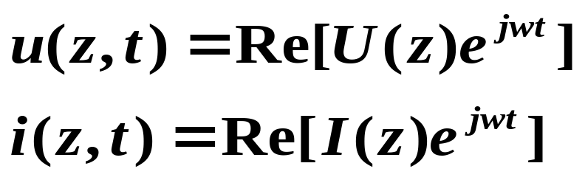
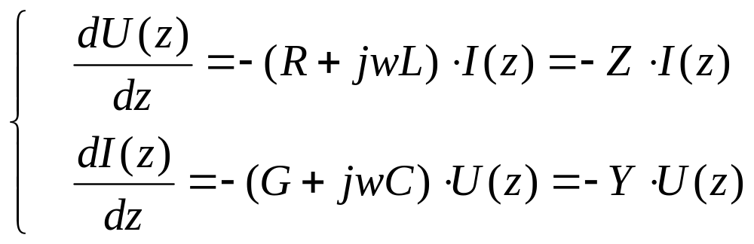
2-1 The lumped-element circuit model for a Transmission line
For the sinusoidal steady -state condition, with cosine-based phasors
Z＝R＋jwL
Y＝G＋jwC

Slide 7
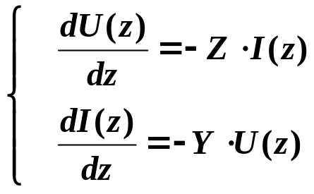
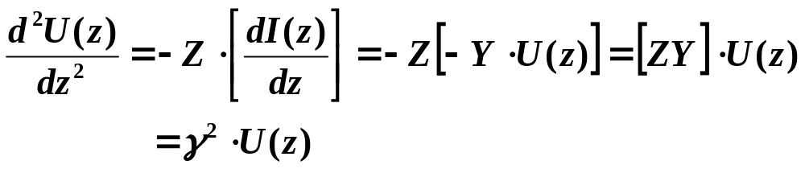
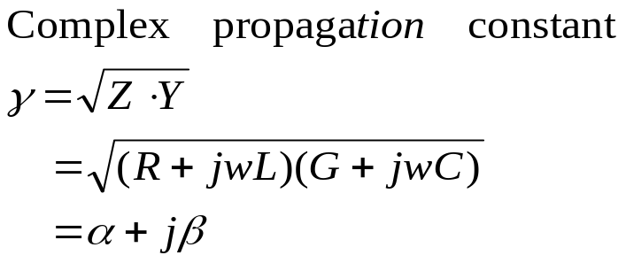
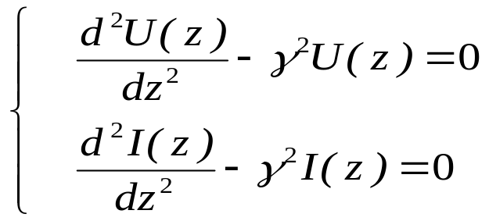
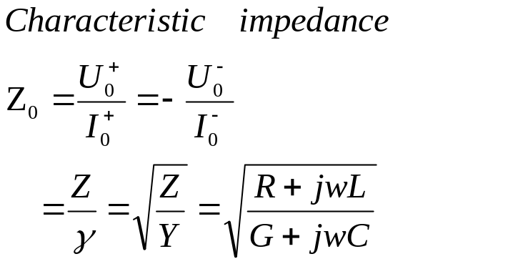
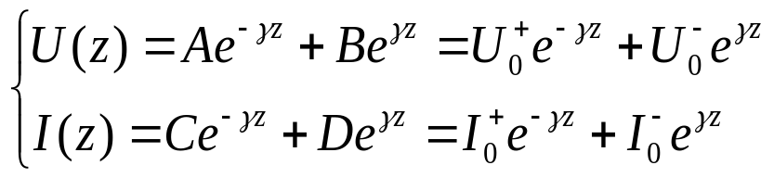
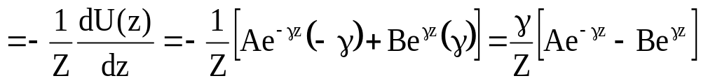
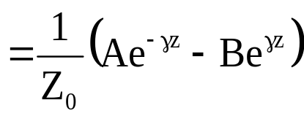
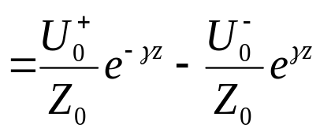
2-1 The lumped-element circuit model for a Transmission line
2. Wave propagation on a Transmission Line
wave equations
general solution
Notes:
U

Slide 8
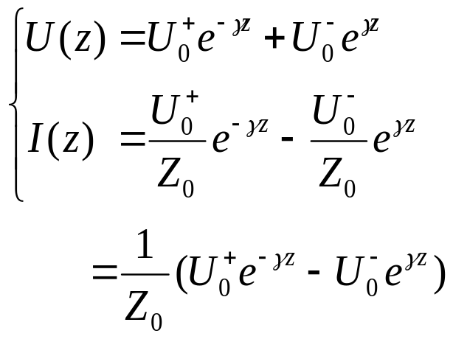


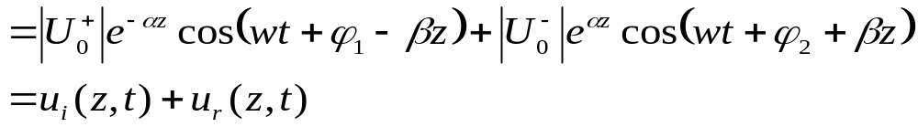
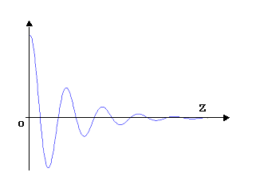
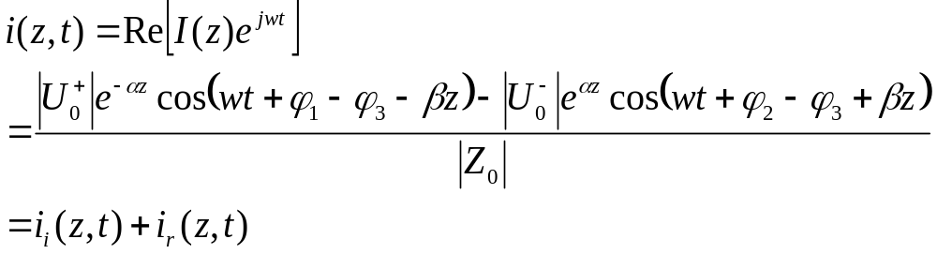
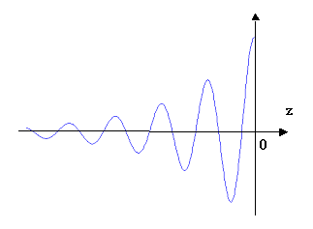
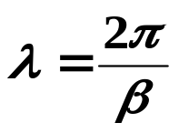
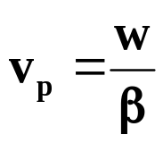

2-1 The lumped-element circuit model for a Transmission line
In the time domain,
Wavelength
Phase velocity ：

Slide 9
Interchangeable Symbols
u or v : time varying voltage
U or V : phasor voltage
Z₀ or Z_{C} : characteristic impedance

Slide 10
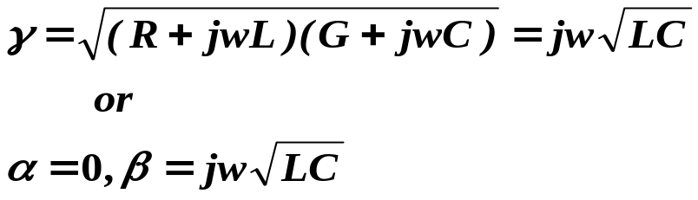
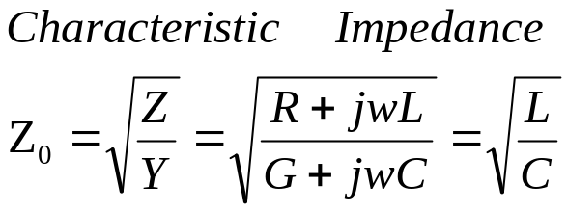
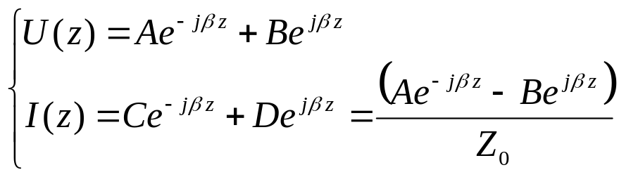
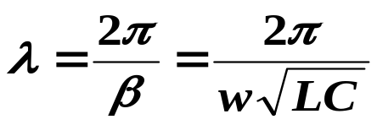
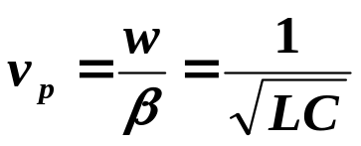
2-1 The lumped-element circuit model for a Transmission line
3. The Lossless Line
setting R=G=0
General solutions
Wavelength:
Phase velocity ：

Slide 11
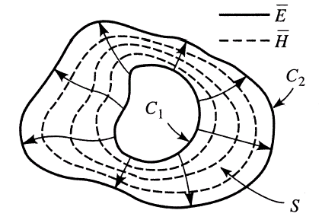
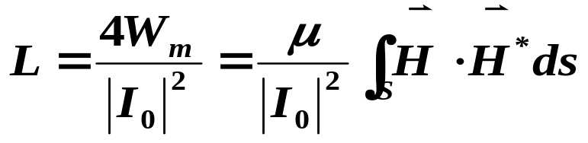
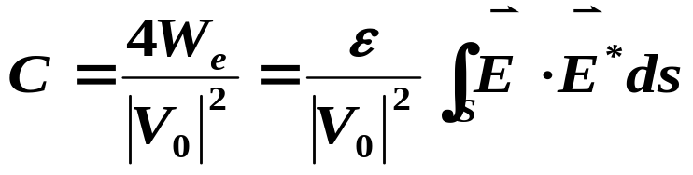
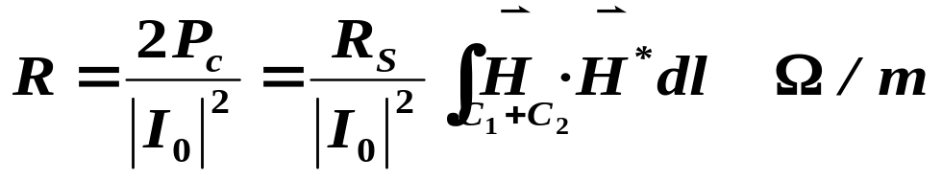
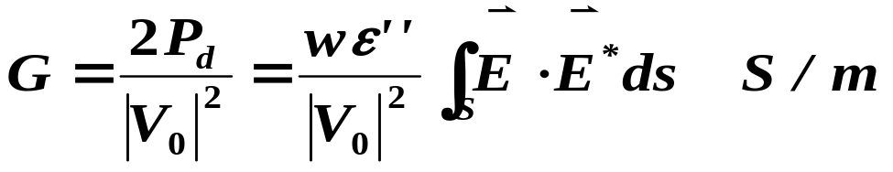
§ 2.2 Field analysis of Transmission line
1. Transmission Line Parameters
Field lines on an arbitrary TEM transmission line.

Slide 12
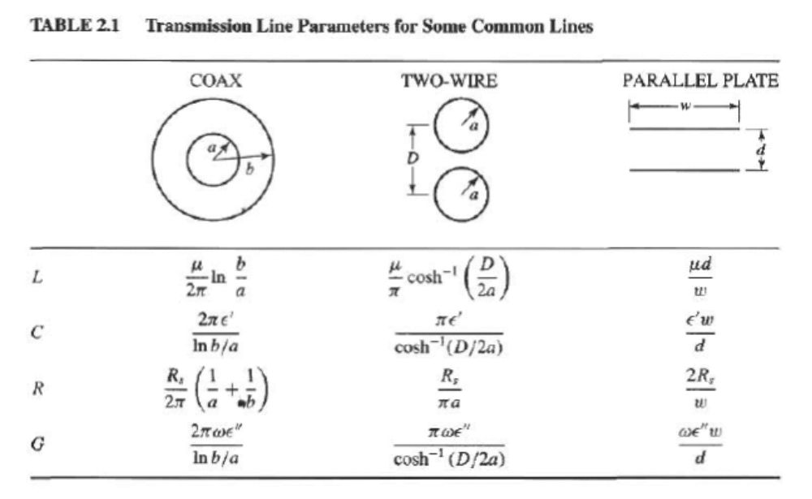
2.2 Field analysis of Transmission line —— Transmission Line Parameters

Slide 13
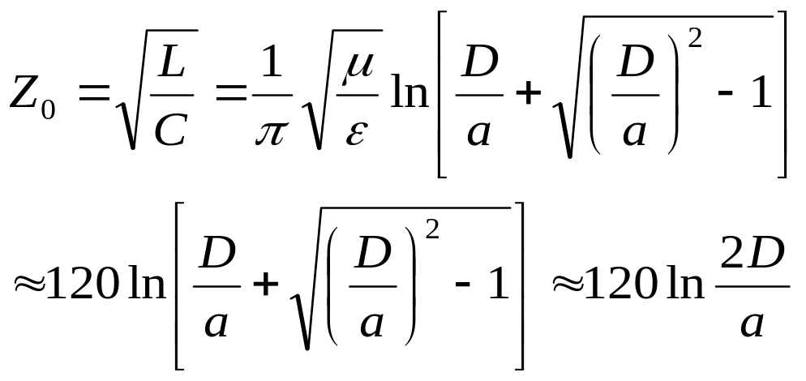
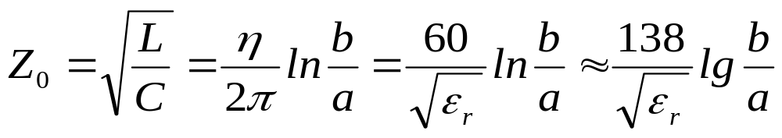
2.2 Field analysis of Transmission line —— Transmission Line Parameters
Two wire：
usually about 250~700Ω,
Coaxial line：
usually：50Ω，75Ω。

Slide 14
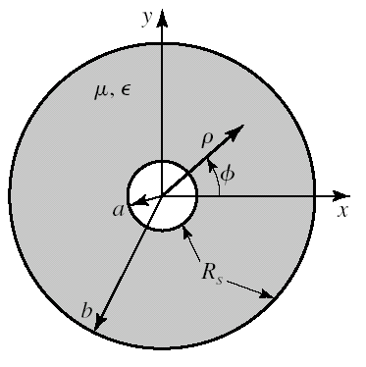
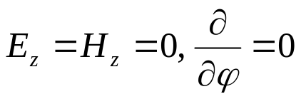
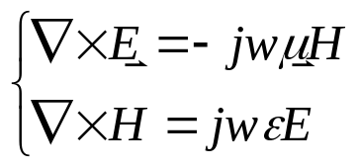
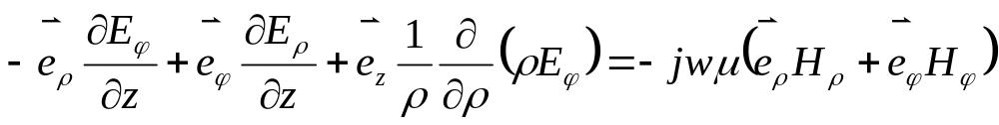
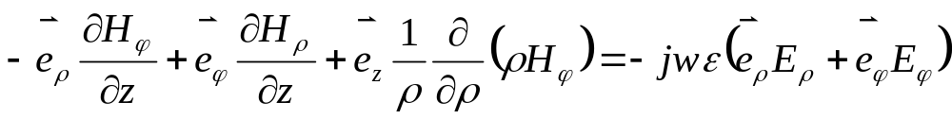
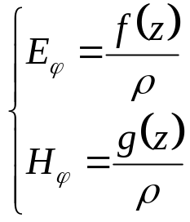
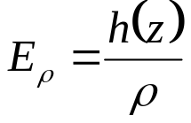
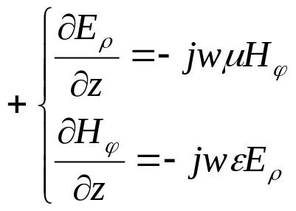
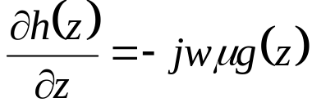
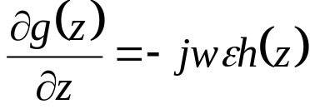
2.2 Field analysis of Transmission line
2. The Telegrapher Equations Derived from field analysis of a coaxial line

Slide 15
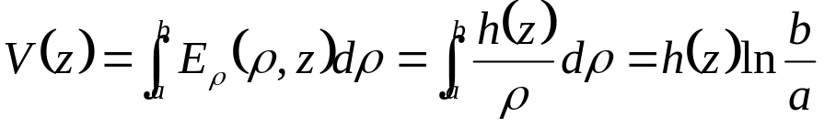












2.2 Field analysis of Transmission line- Telegrapher Equations
Voltage between two conductors
Total current on the inner conductor @ ρ=a
（Excluding R，since assuming σ=∞）

Slide 16






2.2 Field analysis of Transmission line
3. Propagation Constant，Impedance, and Power Flow for the lossless Coaxial Line
β is of the same form as for plane waves in a lossless dielectric medium. This is a general result for TEM transmission lines.
coaxial line
in free space（μ、ε）
Notes:
Attenuation

Slide 17



2.2 Field analysis of Transmission line —— propagation constant, impedance and power flow for the lossless coaxial line
Wave impedance is identical to the intrinsic impedance of the medium for TEM transmission lines.
Geometry dependent
Agree with circuit theory. This shows that the flow of power in a transmission line takes place entirely via the electric and magnetic fields between the two conductors; power is not transmitted through the conductors themselves.

